Slide 1


The 5th Annual Agricultural Policy Conference
13th- 15th February 2019
Dodoma, Tanzania

Slide 2
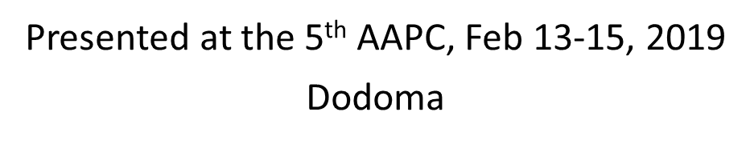
Nutrition Facts and Figures

Slide 3
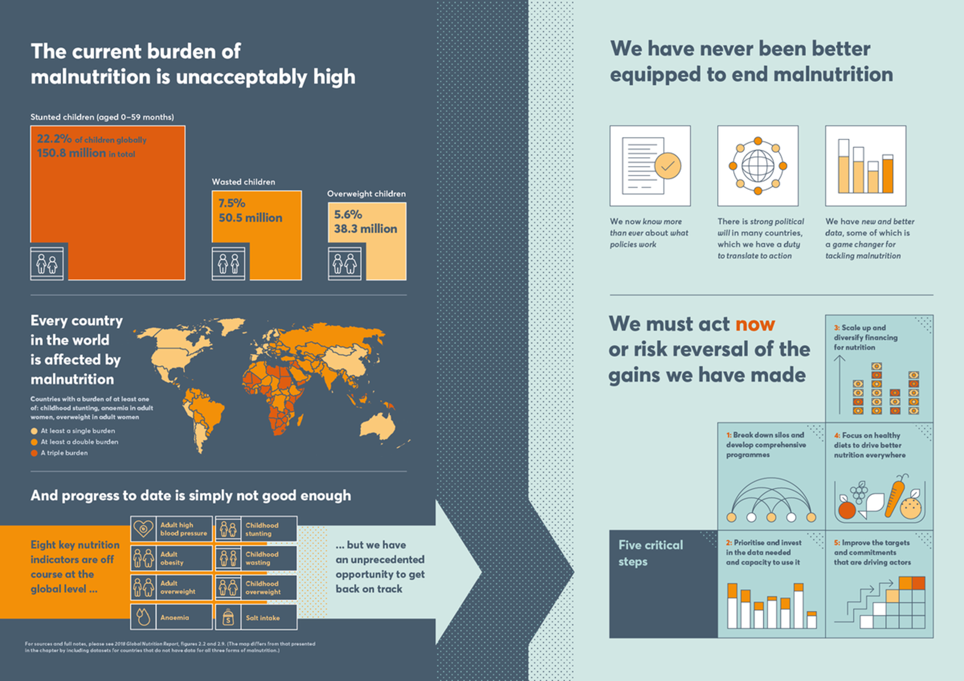
Globally (Source: Global Nutrition Report, 2018)

Slide 4
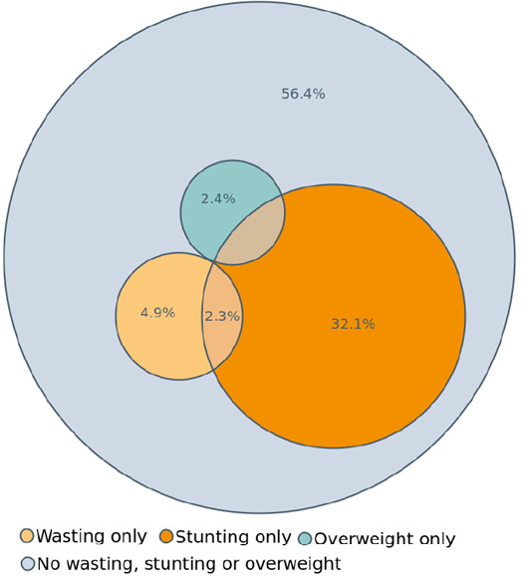
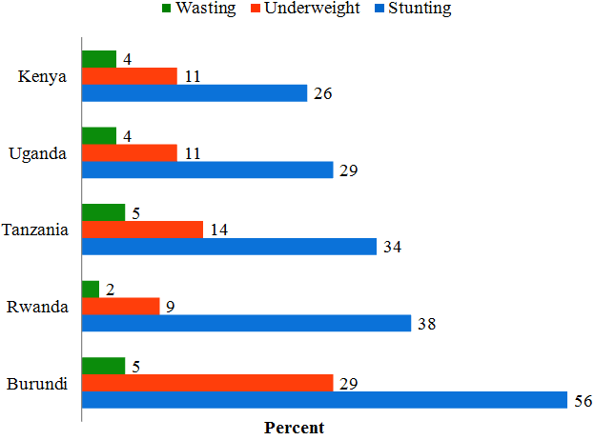
Eastern Africa: Under-fives
Source: Country DHS (2014-16)
Source: UNICEF, Division of Data Research and Policy, 2018

Slide 5
END
Looking at the current nutrition facts and figures and as we discuss during these three days, we should be asking ourselves:
Why millions of children under five in Tanzania are still stunted?
How is the value chain under ASDP2 contributing towards improving nutrition outcome?
What are the opportunities at the intersection of agriculture and health to improve food and nutrition security?

